Slide 1
ICTNWK541 Assessment
Assessment Task 2: Project Portfolio
Manuel Sergio Perez Espitia

Slide 2
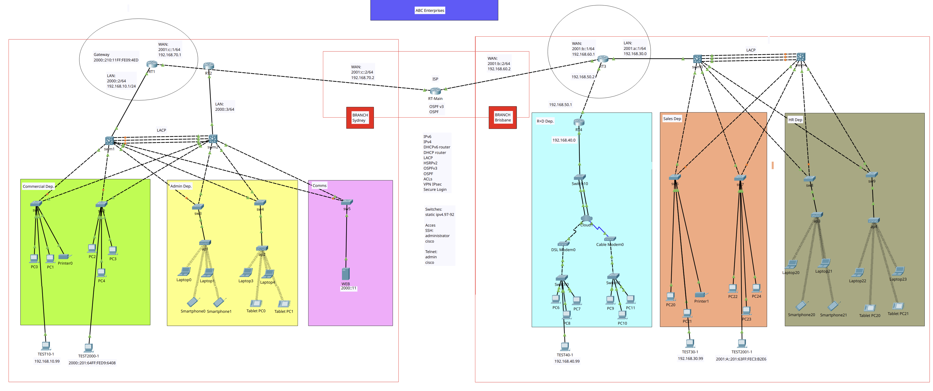
ABC Enterprises WAN Expansion

Slide 3

We are the network engineer responsible for implementing the required WAN connectivity for ABC Enterprises.
ABC Enterprises wants to improve its network due to old infrastructure, security and reliability WAN connectivity between Sydney Branch and Brisbane Branch.

Slide 4
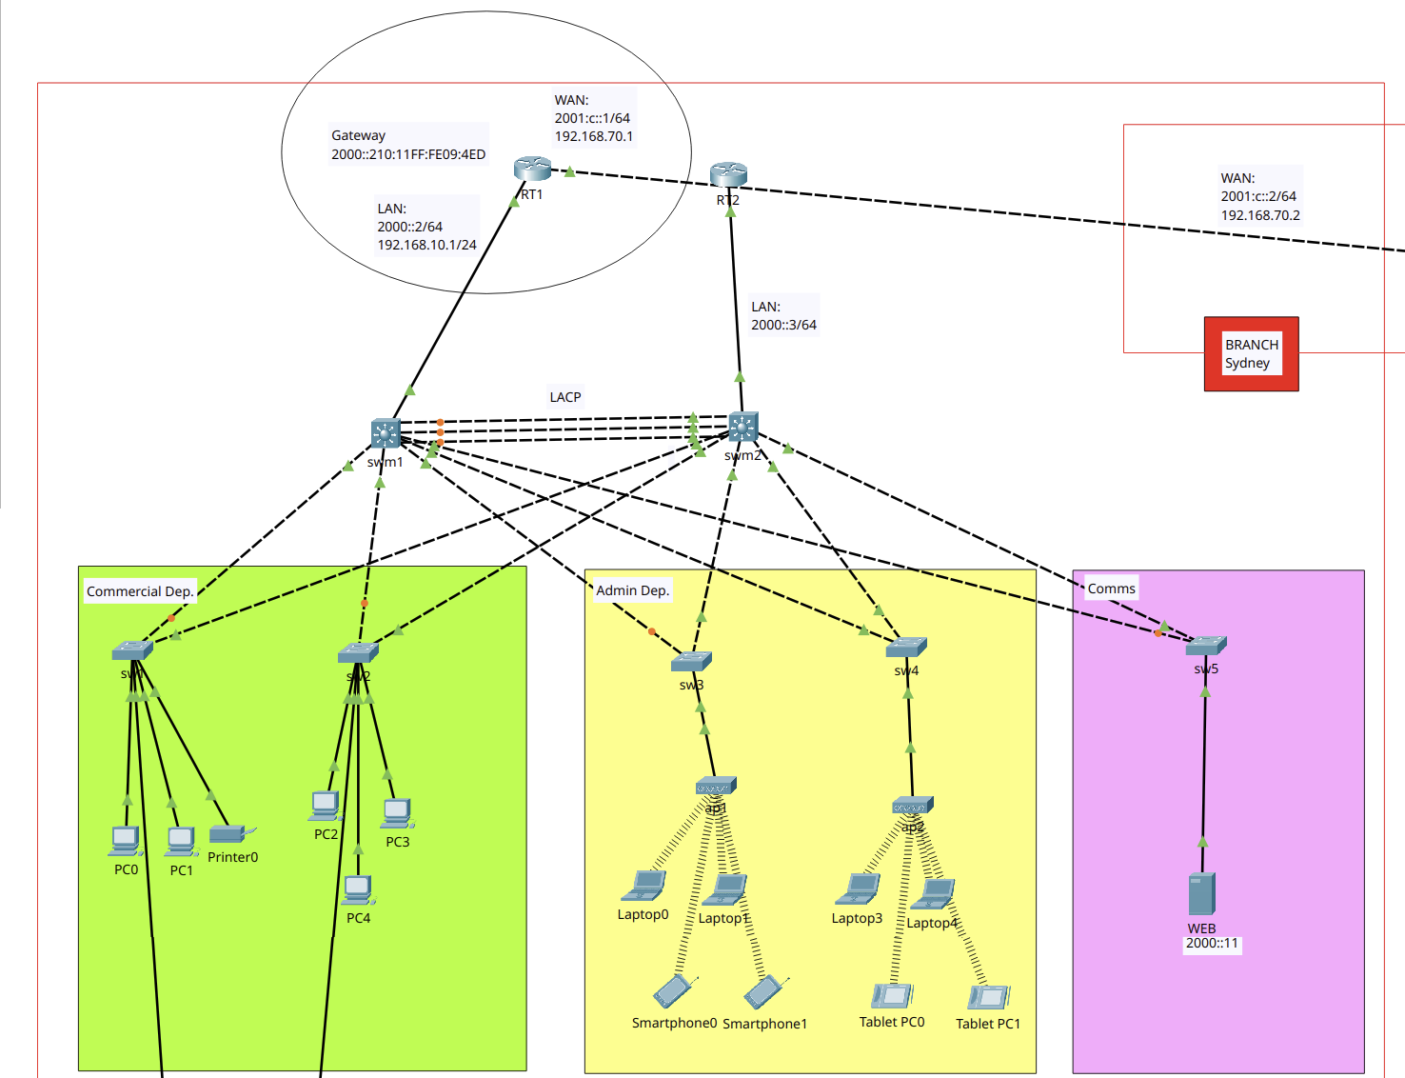
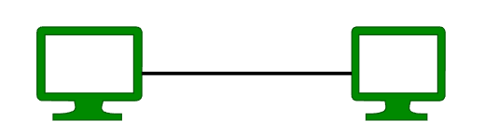
Sydney Branch

Slide 5
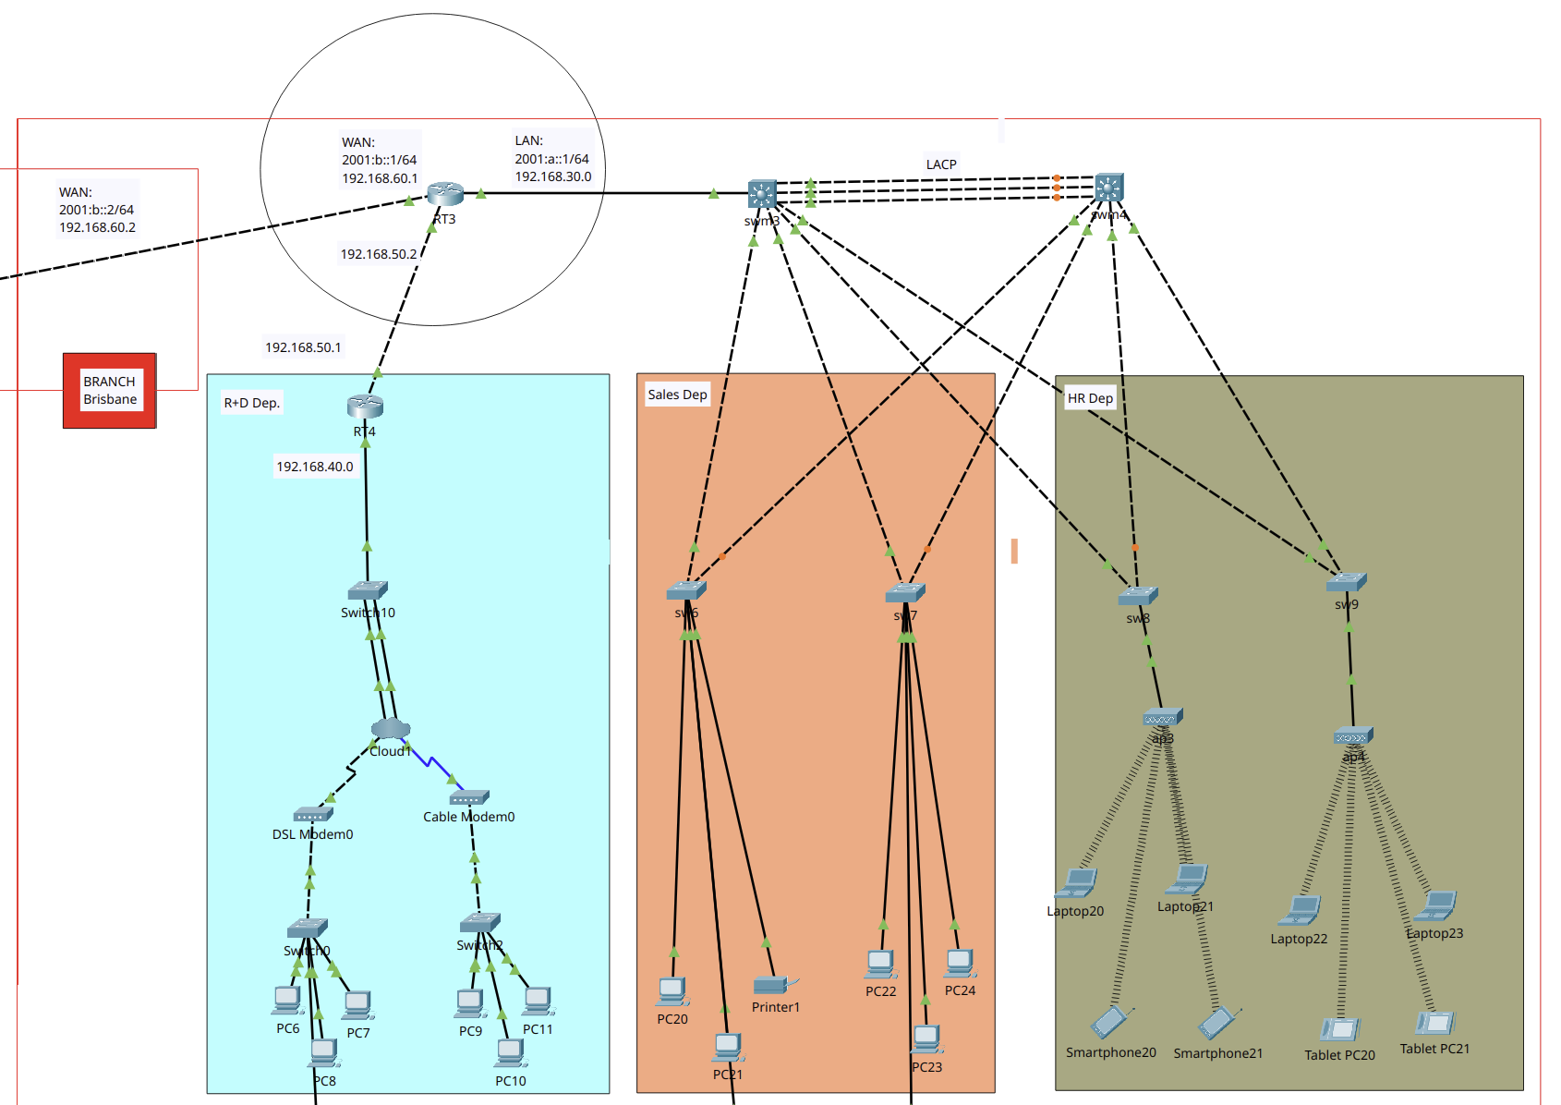
Brisbane Branch

Slide 6

Simulation Software & Tools
Cisco Packet Tracer 8.2.2
Ubuntu 24.04 LTS
Wireshark 4.2.2

Slide 7
Network Details
Sydney Branch
Type: LAN/WAN
Topology: Dual-Star high availability
Architecture: 3-Tier
Brisbane Branch:
Type: LAN/WAN
Topology: Dual-Star high availability
Architecture: 2-Tier

Slide 8
Network Nodes
Sydney |  | Brisbane
2 (HA) | Routers | 2
5 | Switches | 5
2 (HA) | Switches L3 | 2 (HA)
1x1x0 | Servers, Printers, Modems | 0x1x2
1 | End Devices | 19

Slide 9

Content
Legal & security: Policies and Procedures
WAN Configuration and Troubleshooting & Testing
Summary Technologies & Protocols

Slide 10
Legal & security: Policies and Procedures

Slide 11

Legal & security
ABC Enterprises adopts security technologies to ensure data protection. The company's policies are outlined below.

Slide 12

Legal & security
Service Password Encryption
Policy to prevent access to plain-text passwords in network devices.
ISO/IEC 27001

Slide 13

Legal & security
Mandatory Login Password
Policy on all network devices that requires a login password for any access to routers or switches.
NIST SP 800-53 (IA-2)

Slide 14


Legal & security
VPN Site-to-Site
Policy implements IPSec to protect data in transit between different company branches over internet.
NIST SP 800-77

Slide 15

Legal & security
Access Control Lists (ACLs)
Policy to filter traffic and control access between subnets, enhance internal network security.
ISO/IEC 27002 (s13)

Slide 16

Legal & security
Secure Remote Access to infrastructure
Policy to protect remote access by Telnet and SSH to network devices using password-protected and encrypted.
NIST SP 800-5

Slide 17
WAN Configuration
Installation Plan

Slide 18
WAN Configuration
Secure Access by SSH & Telnet
Additional Protocols: DHCP
Additional Protocols: LACP
Additional Protocols: HSRP
Additional Protocols: OSPF
Additional Protocols: OSPF
WAN protocols: ACL
WAN Protocols: VPN
WAN Protocols: PPP
Dynamic NAT
Firewall Single-port
Logging Network

Slide 19
Troubleshooting & Testing
Local

Slide 20
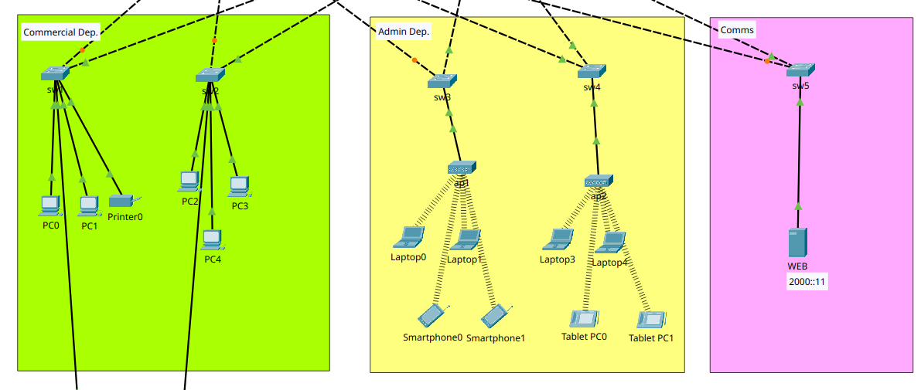
Sydney Branch

Slide 21
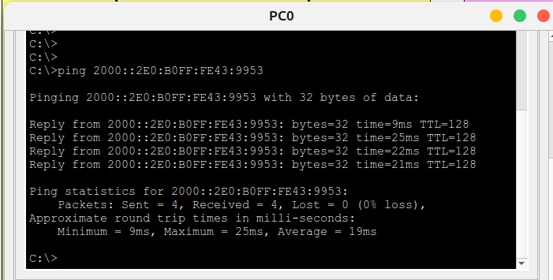
Sydney Branch - Local
Commercial and Admin over IPv6PC0 LAPTOP0

Slide 22
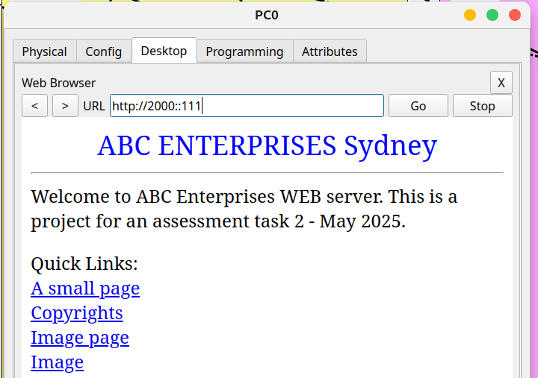
Sydney Branch - Local
Commercial and Comms over IPv6
WEB PC0

Slide 23
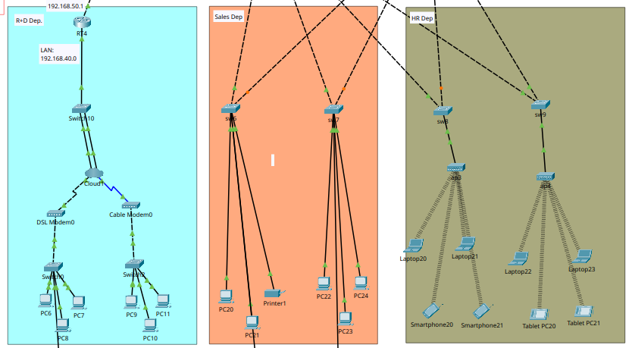
Brisbane Branch

Slide 24
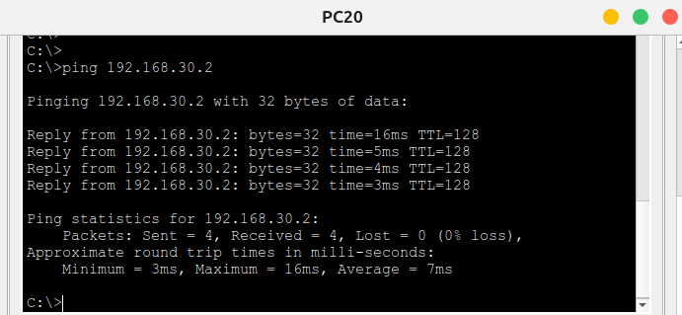
Brisbane Branch - Local
Sales and HR over IPv4
PC20 LAPTOP20

Slide 25
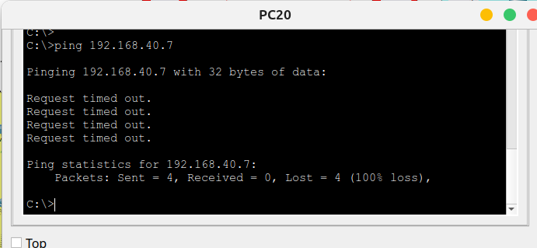
Brisbane Branch - Local
Sales and R+D HR and R+D over IPv4 After implement VPN this connection is no longer available, I could not fixed it.

Slide 26
Troubleshooting & Testing
WAN

Slide 27
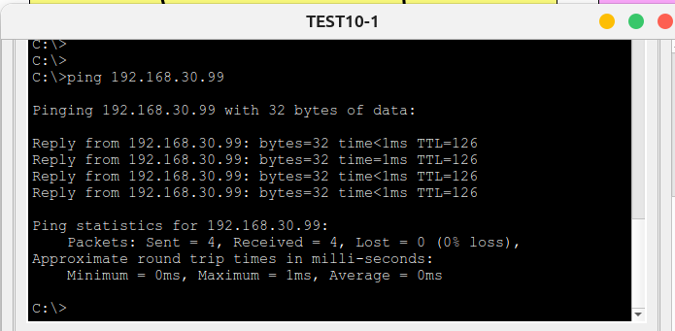
Brisbane Branch - Local
Sydney Branch and Brisbane Branch over IPv4

Slide 28
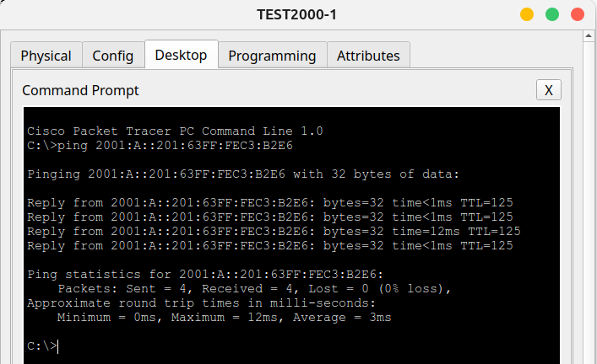
Brisbane Branch - Local
Sydney Branch and Brisbane Branch over IPv6

Slide 29
Secure Access SSH & Telnet
WAN

Slide 30
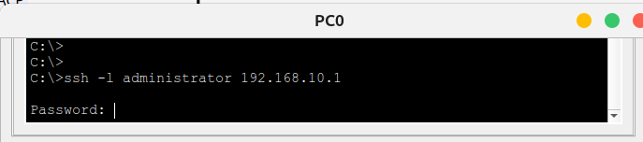
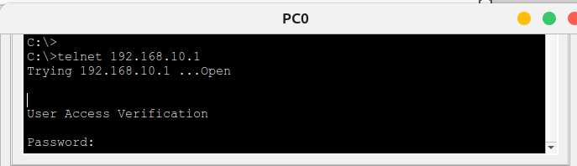
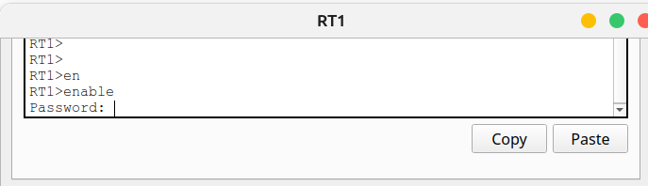
Secure Access
RT1 192.168.10.1

Slide 31
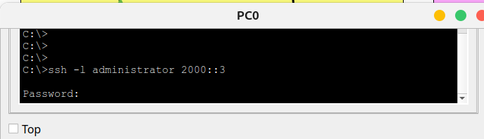
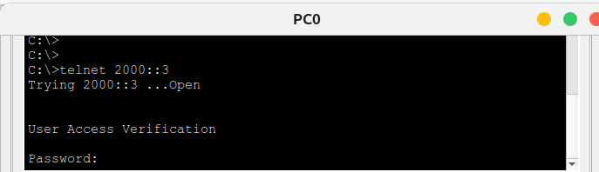
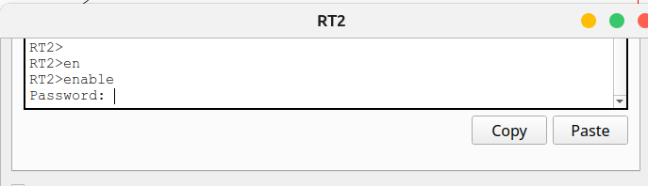
Secure Access
RT2 2000::3

Slide 32
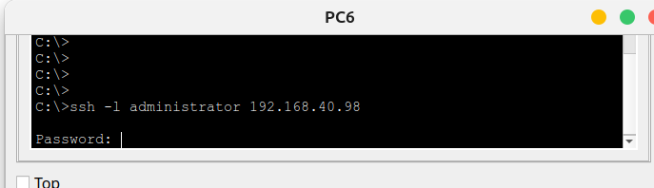
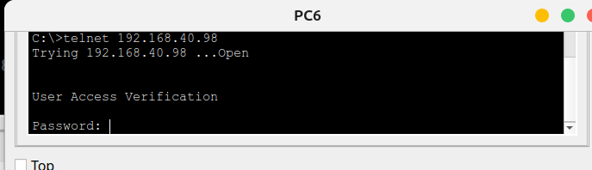
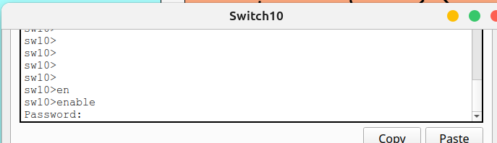
Secure Access
sw10 VLAN1:192.168.40.98

Slide 33
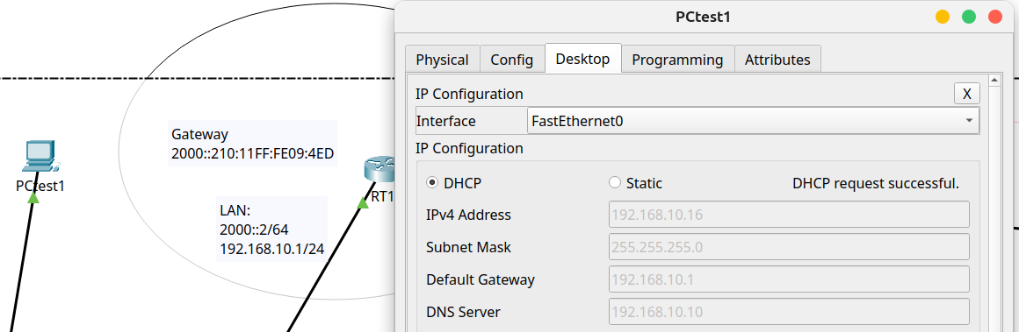
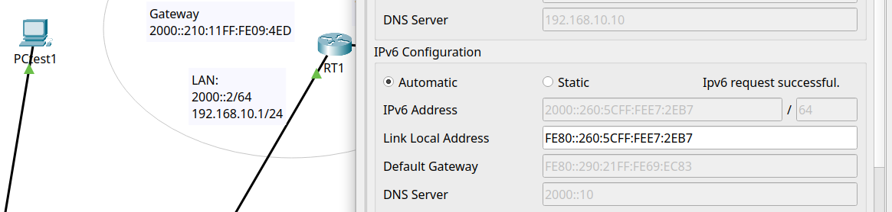
Sydney Branch
RT1 New PC configured to DHCP and IPv6 Auto

Slide 34
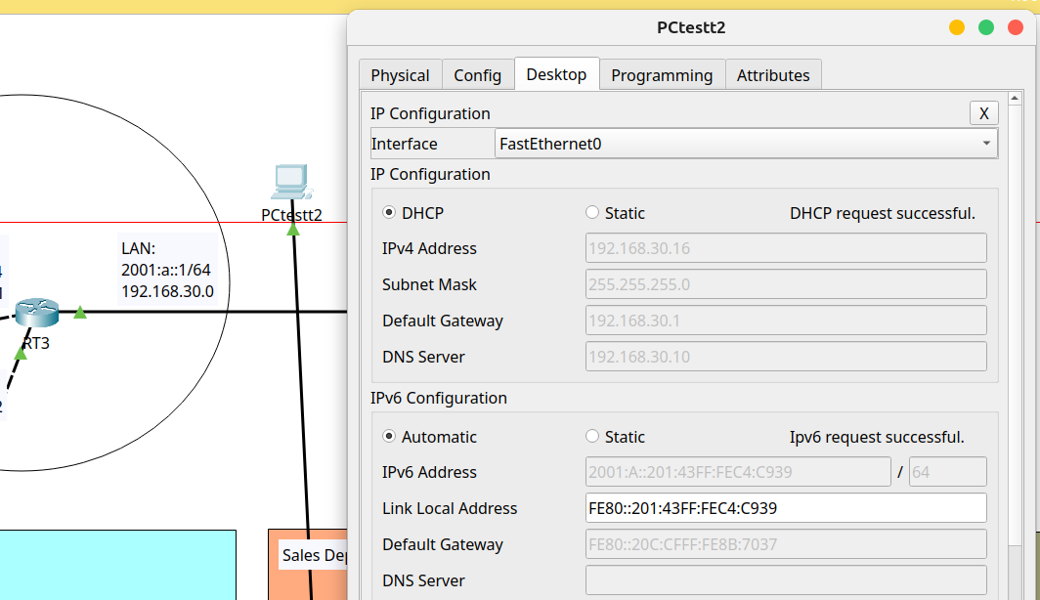
Brisbane Branch
RT3
New PC configured to DHCP and IPv6 Auto

Slide 35
Testing LACP
WAN – IPv6

Slide 36
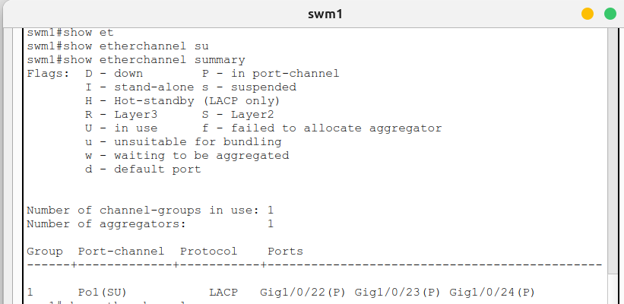
Summary port-channel
Sydney
Summary config

Slide 37
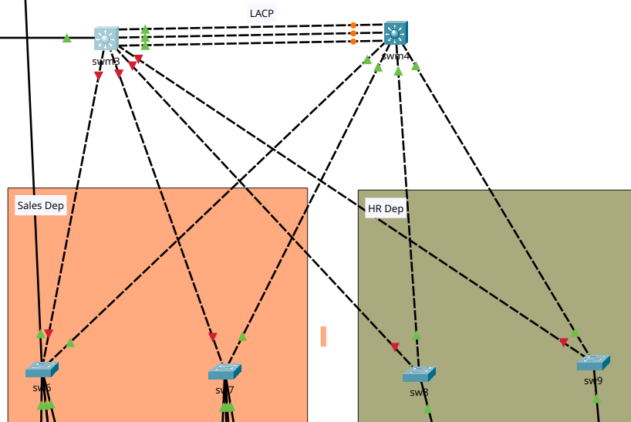
LACP - Brisbane Branch
Turned Down swm3 interfaces

Slide 38
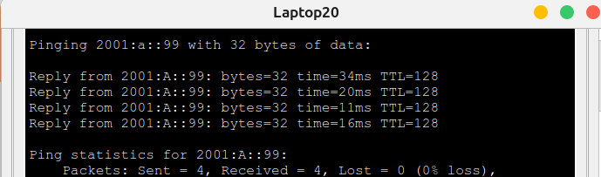
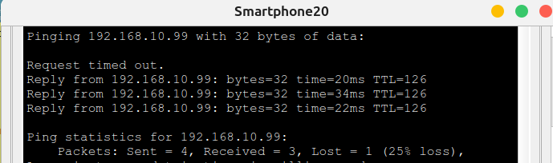
Brisbane Branch
Connections are still working...

Slide 39
Testing HSRP
Sydney – IPv6

Slide 40
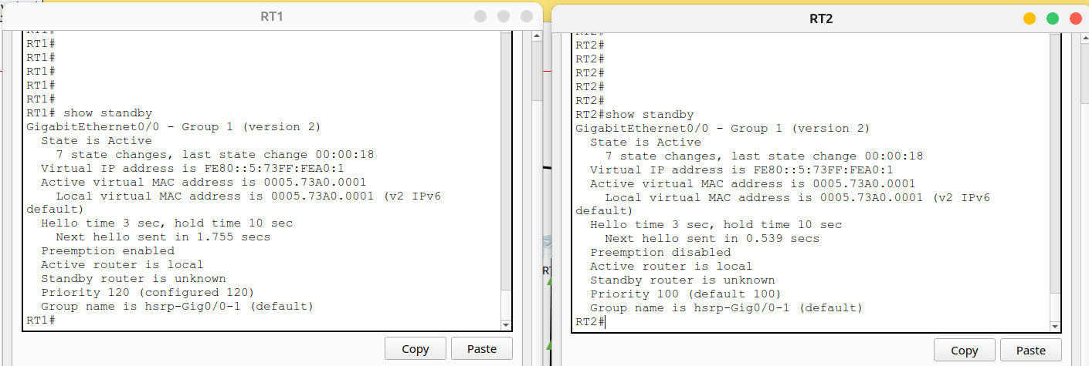
HSRP
Primary (priority 120) and secondary router (priority 100).

Slide 41
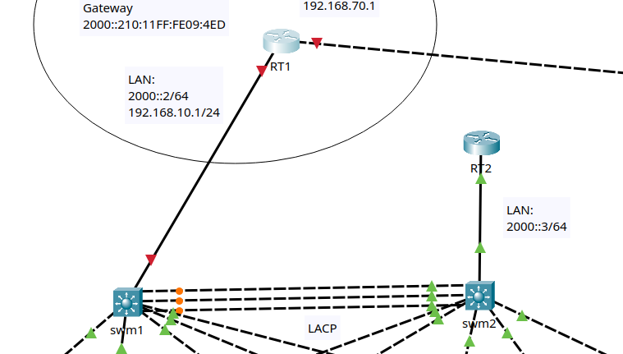
HSRP
The primary router will be turned off to verify network behaviour.

Slide 42
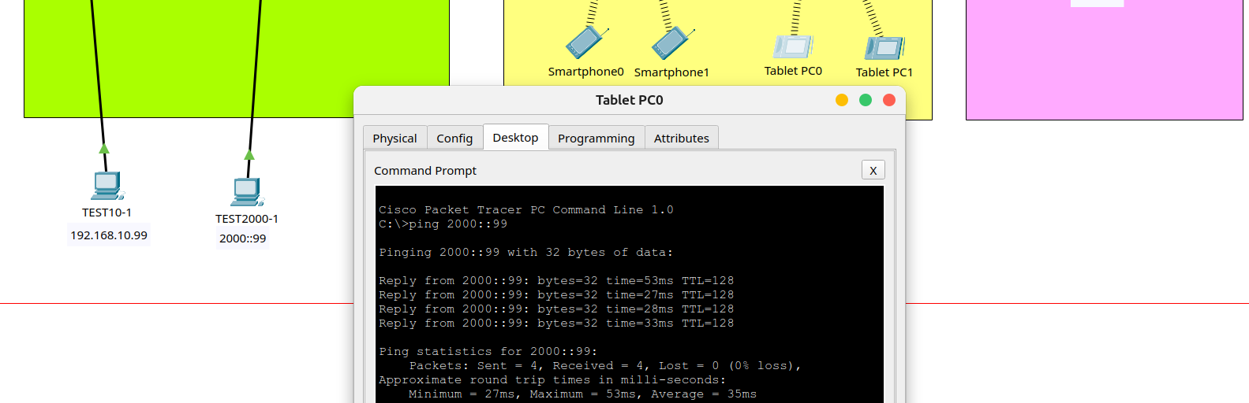
HSRP
RT2 keeps LAN working...

Slide 43
Testing OSPF
WAN

Slide 44
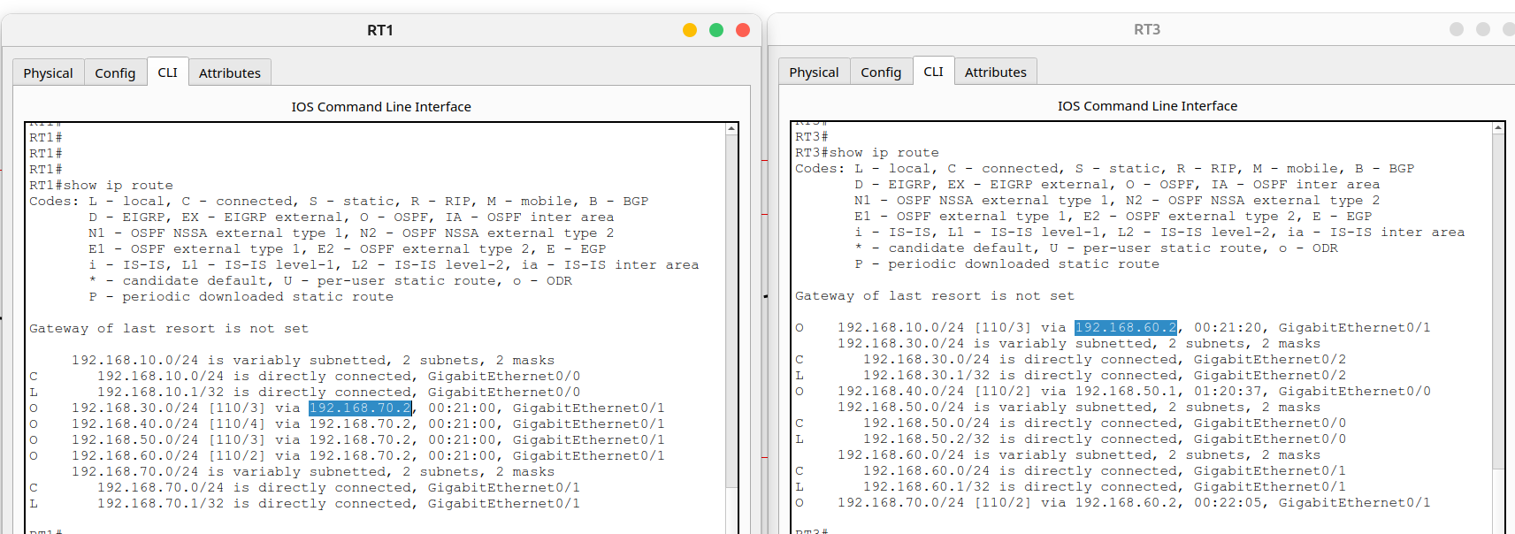
HSRP
Routes between devices are proved by OSPF

Slide 45
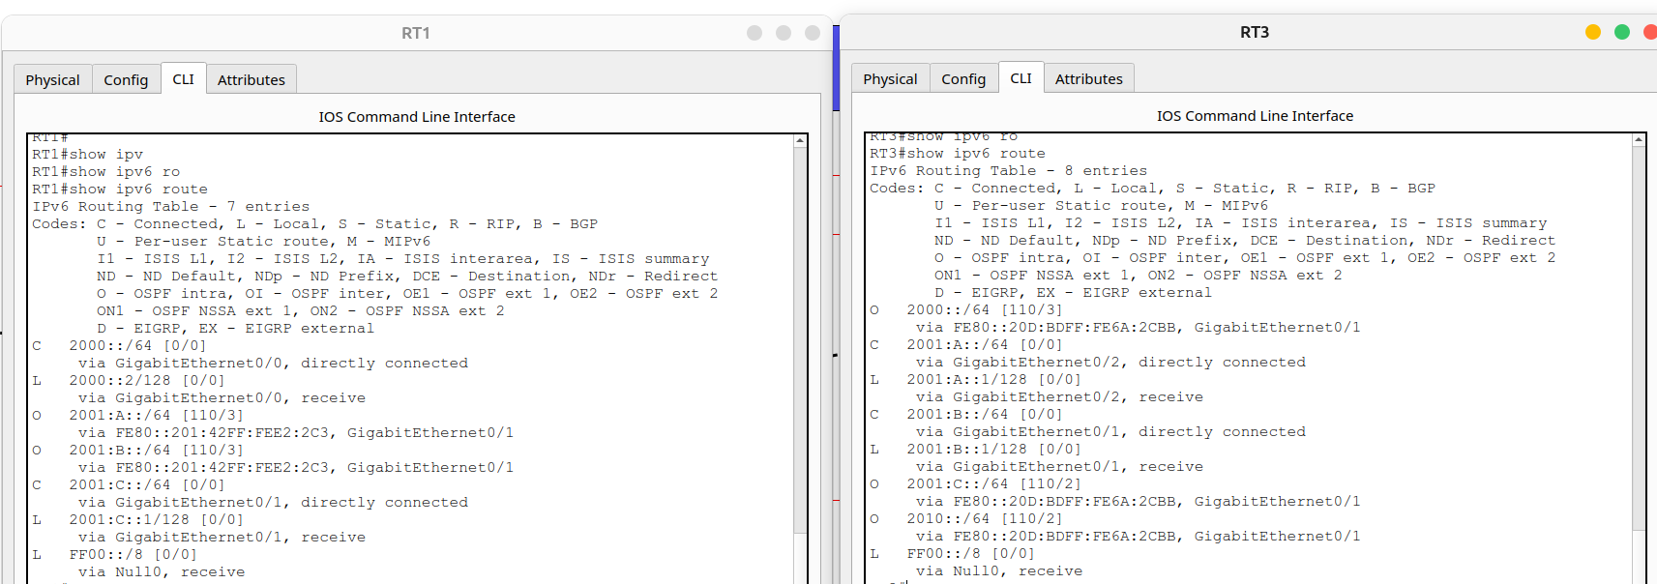
HSRP
Routes between devices are proved by OSPFv3

Slide 46
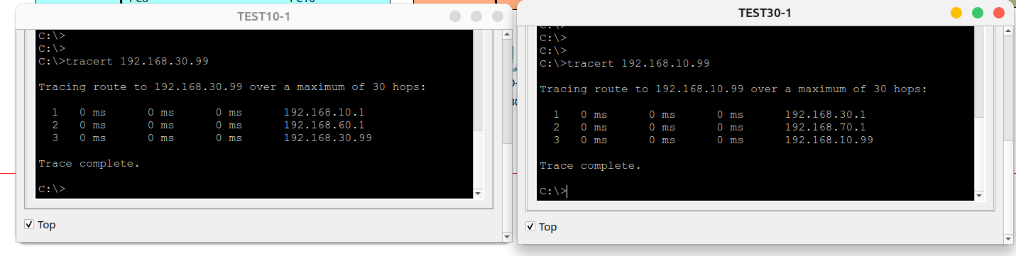
HSRP
Bidirectional trace route between Sydney Branch and Brisbane Branch over IPv4

Slide 47
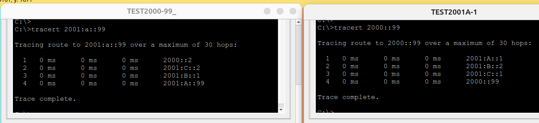
HSRP
Bidirectional trace route between Sydney Branch and Brisbane Branch over IPv6

Slide 48
Testing ACL
WAN – IPv4

Slide 49
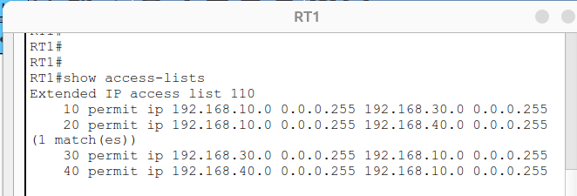
ACL
Example ACL on R1 (Sydney Branch)

Slide 50
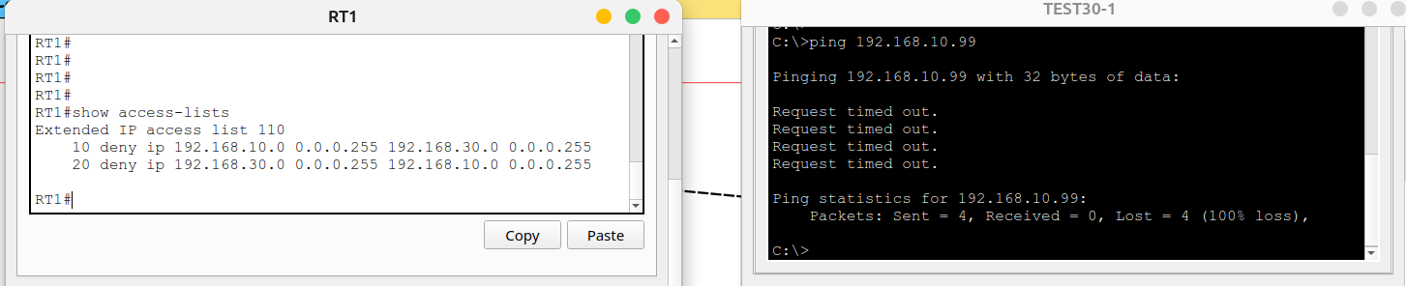
ACL
Deny rule for testing traffic from 192.168.10.99 (Brisbane)

Slide 51
Testing VPN Site-To-Site
WAN – IPv4

Slide 52
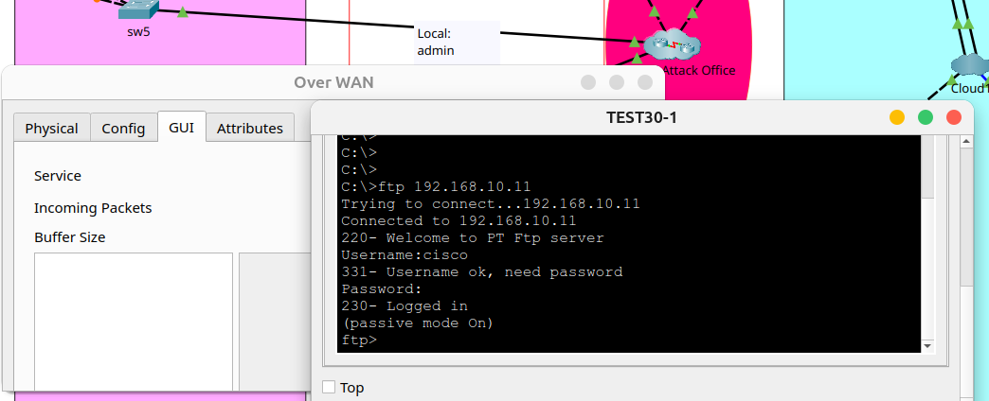
VPN Site-To-Site
Internet connection are intercepted by a criminal sniffer. FTP Messages cannot be captured.

Slide 53
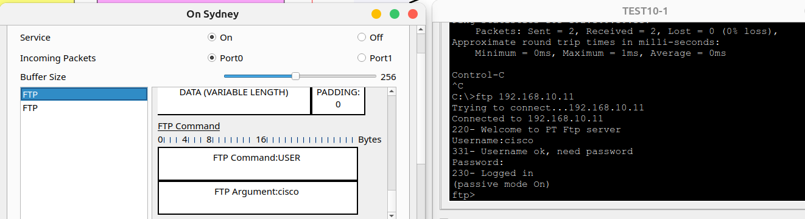
VPN Site-To-Site
Local connection are susceptible to attacks. FTP Messages can be captured.

Slide 54
Testing Encapsulation PPP
IPv4

Slide 55
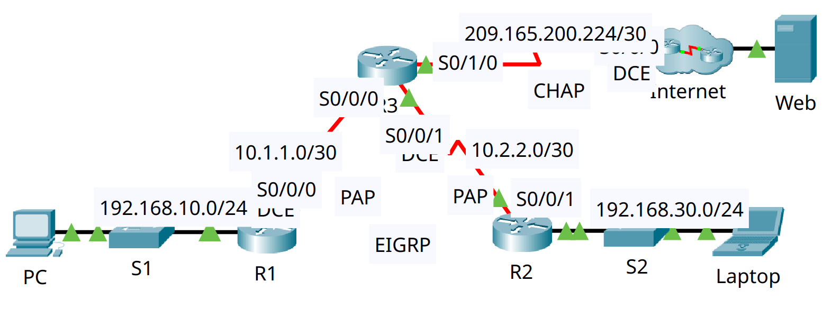
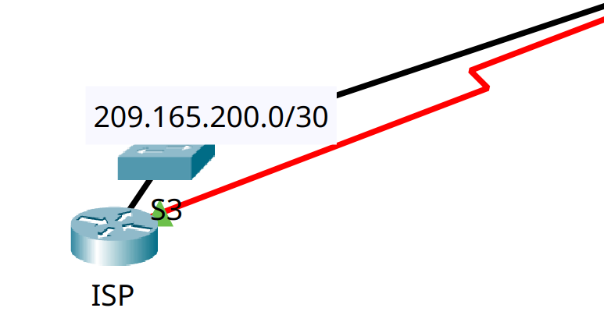
Encapsulation PPP
Implemented CHAP as an automatic authentication method.

Slide 56
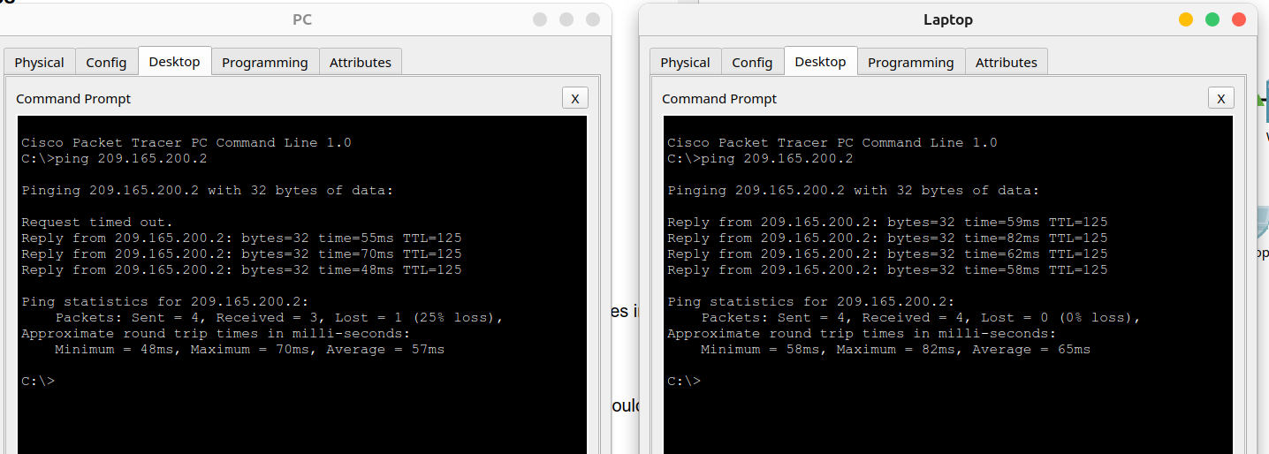
Encapsulation PPP
Connection from Local network to WEB server are working under encapsulation method. CHAP implemented.

Slide 57
Dynamic NAT
IPv4

Slide 58
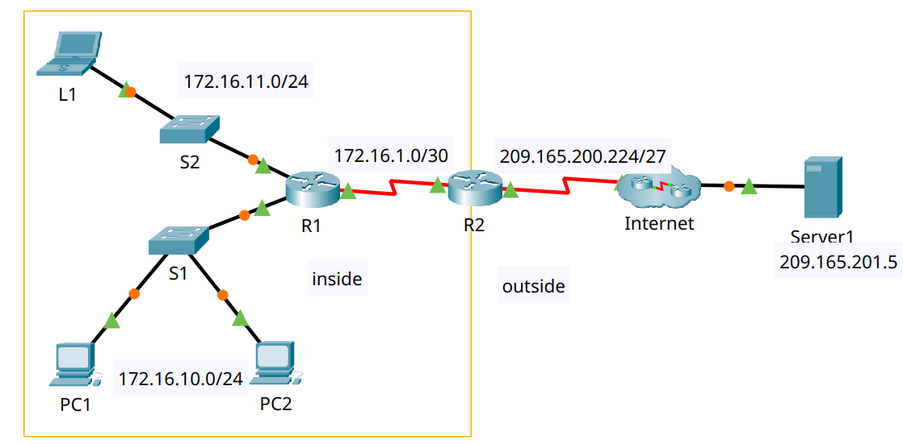
Dynamic NAT
WAN Network

Slide 59
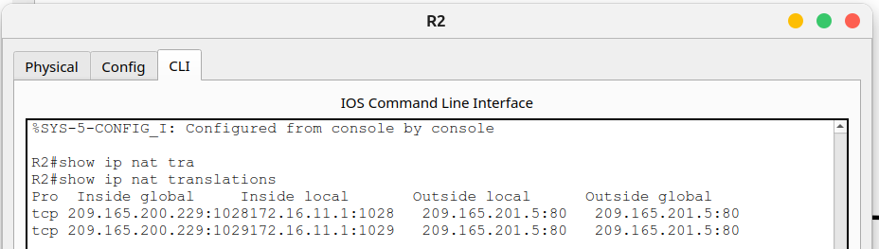
Dynamic NAT
R2 NAT Translations table on

Slide 60
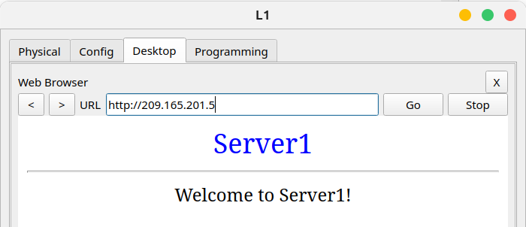
Dynamic NAT
Testing WEB connection

Slide 61
Testing Firewall and Single-port
IPv4

Slide 62
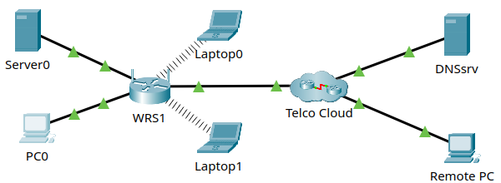
Firewall Single-port
WAN network

Slide 63
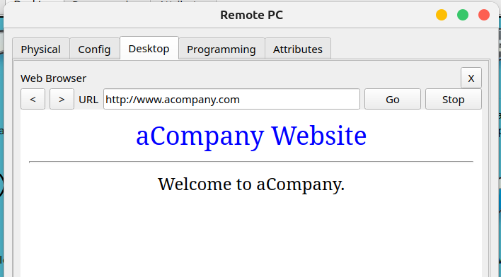
Firewall Single-port
Single-port enabled and DMZ disabled
Connection from Remote PC to WEB Server

Slide 64
Logging Network
IPv4

Slide 65
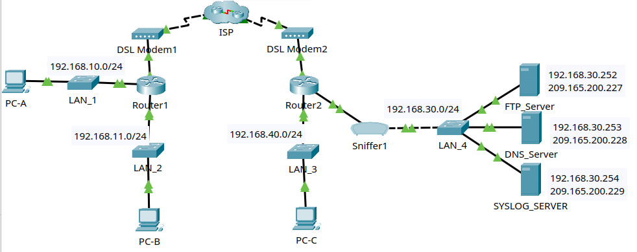
Logging
WAN Network

Slide 66
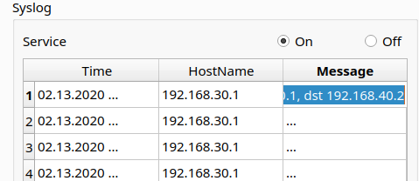
Logging
Echo replies from R2 to PC-C its destination is LAN interface of R2 (because is its local network)

Slide 67
Summary Technologies & Protocols

Slide 68
Summary Technologies
DHCP (Dynamic Host Configuration Protocol):
Automatically assigns IP, gateway, and DNS addresses to devices on the network
LACP (Link Aggregation Control Protocol):
Combines several physical links to form a single logical link for the purpose of increasing bandwidth also providing redundancy when one of the switches fails.

Slide 69
Summary Technologies
HSRP (Hot Standby Router Protocol):
Provides redundancy. If the primary router fails, another router automatically takes over, ensuring service continuity.
OSPF (Open Shortest Path First):
Dynamic routing that allows the calculation of the most efficient route to send packets in a network.

Slide 70
Summary Technologies
ACLs (Access Control Lists):
Rules applied to allow or deny traffic. They are used to filter traffic and improve security.
VPN IPsec (Internet Protocol Security):
Creates secure (encrypted) connections over the Internet between two networks (site-to-site), protecting data confidentiality and integrity.

Slide 71
Summary Technologies
PPP Authentication (Point-to-Point Protocol Authentication):
Responsible for establishing point-to-point connections and provides encapsulation to facilitate the connection. Also supports authentication mechanisms (CHAP) between two network devices to add an additional layer of security.

Slide 72
Summary Technologies
Dynamic NAT (Dynamic Network Address Translation):
Map a public network to multiple private networks on a WAN to communicate with external IPs..

Slide 73
Bibliography
Network System: Gurutech Networking Training - Secure Network Training
DHCPv6 Router: Gurutech Networking Training - DHCPv6
DHCPv6 stateless-stateful: ShefferKimanzi - DCHP v6 configuration
LACP: ITExamAnswers.net - Configure EtherChannel l
HRSP v2 IPv6: Packet Tracer Network - HSRP Configuration
IPCisco.com: ADSL IPv6
ACLs: Packet Tracer Network - ACLs
OSPFv3: Networking Academy - IPv6 OSPFv3
OSPf: Computer Networking - OSPF
VPN IPsec tunnel (site-to-site): Abdullah Irfan, Medium, VPN tunnel
VPN site-to-site, IPsec: Gurutech Networking Training - VPN IPsec
SSH: Sheffer Kimanzi, Configuring ssh
Telnet: Sheffer Kimanzi, Configuring telnet
Dynamic NAT: ComputerNetworkingNotes - Dynamic NAT

